Slide 1
Weekly Update
Jorian Bruslind
Week 6

Slide 2
HyperRail Project
Project Goals
Create a modular, inexpensive system to take hyperspectral images of crops
Develop a user friendly interface to for use by technicians, RA’s, etc
Create good documentation for later iteration
Current Status
Developed new system frame for better tension and carriage motion
3D printing new parts for verification, looking to purchase COTS products later
Working with Junior Design teams on standardization
Trying my best to do testing while in quarantine

Slide 3
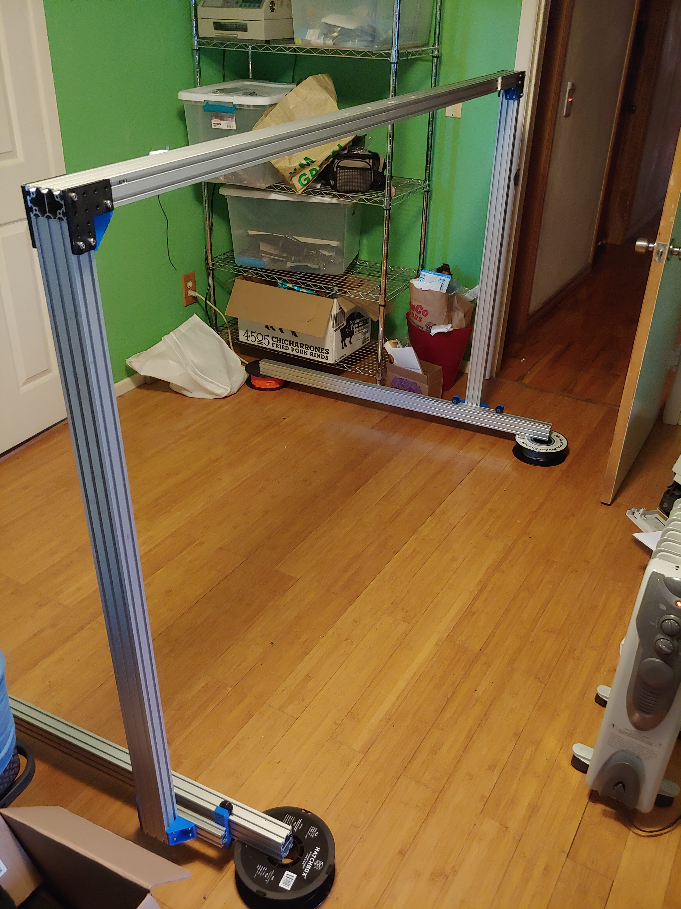
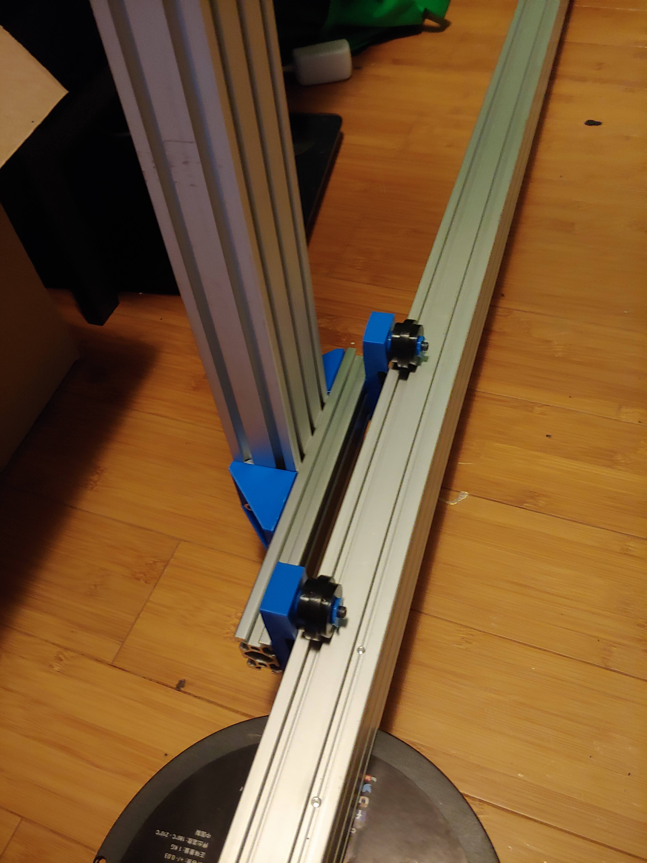
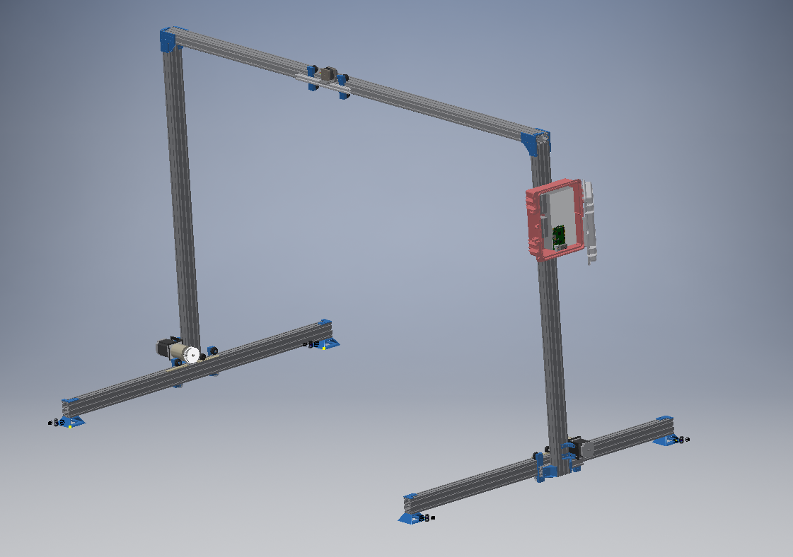
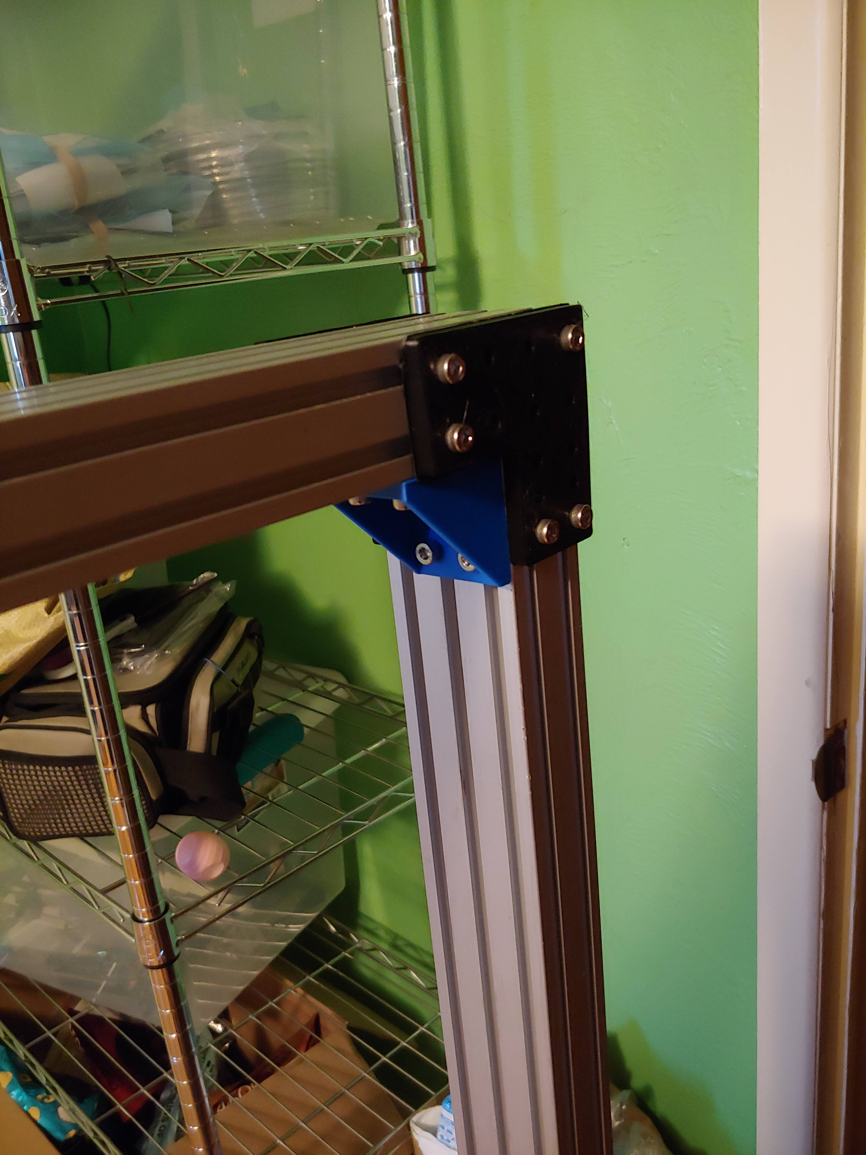
Current Status

Slide 4
Project Work
Junior Design Block 1 Checkoff
Met with Junior Design teams for the Checkoff
Teams seem to be on track and good development so far
Having teams look into using GRBL and Marlin for interpreters
ESP32 implementation for GRBL is awesome
Met with project stakeholders
Established preliminary scope (size, rough cost, deliverables)
Goal is to create at least working module with current parts
Met with STEMbassadors
Student Club on campus dedicated to innovation and CNC machines
Very excited about HyperRail Project

Slide 5
Other Work
Midterms
Nvidia Internship :D

Slide 6
My Plan
Create complete block diagram with project timeline
Look into SpyderBot for different implementation
Get a rough order of magnitude (ROM) for system costs
Create system artifacts
System Interconnect Diagram (SID)
Bill of Materials
Software flowchart / state machine

